Slide 1





Battery Thermal Management Using Heat Pipe Integrated System
KONGU ENGINEERING COLLEGE
PERUNDURAI ERODE-638060
DEPARTMENT OF AUTOMOBILE ENGINEERING
In association with:
Team Mentor with Designation and Department:
Mr. K.Nithyanandhan / Assistant Professor / Auto. Engg.
Team Co-Mentor with Designation and Department:
Dr. P. C. Murugan /Associate Professor / Auto. Engg.

Slide 2
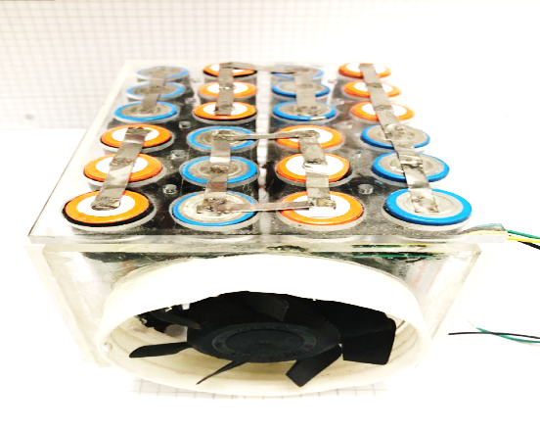



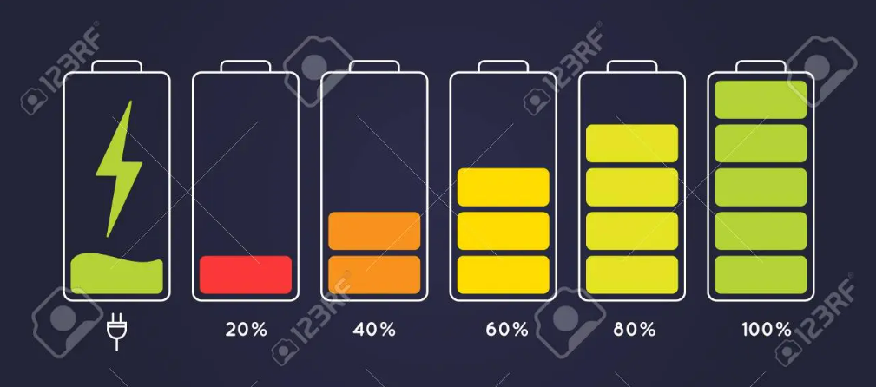


Problem statement:
Existing Technologies
Heating Issues
Cooling
Electric Vehicle
Air Cooling
Reasons
Excess Emission From IC fuelled Vehicle
Charging & Discharging
Environmental condition

Slide 3
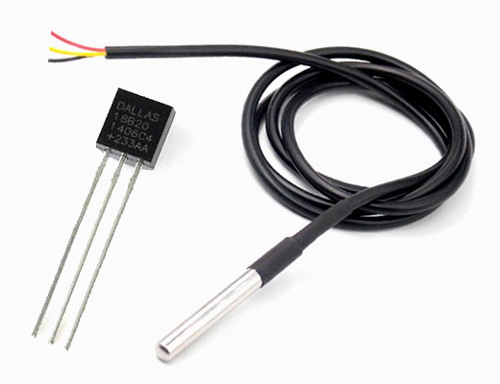



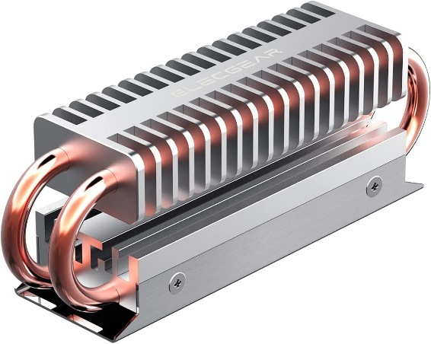
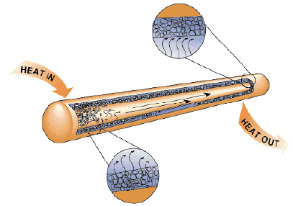
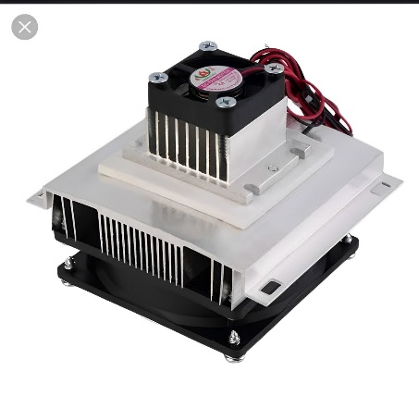

Solution
Heat Removed From Battery Pack
Cell
Heat
Control Module
Temperature Sensor
Heat From the Cell
Result
Heat Pipe Integrated System
Heat Pipe
Peltier cooling system

Slide 4

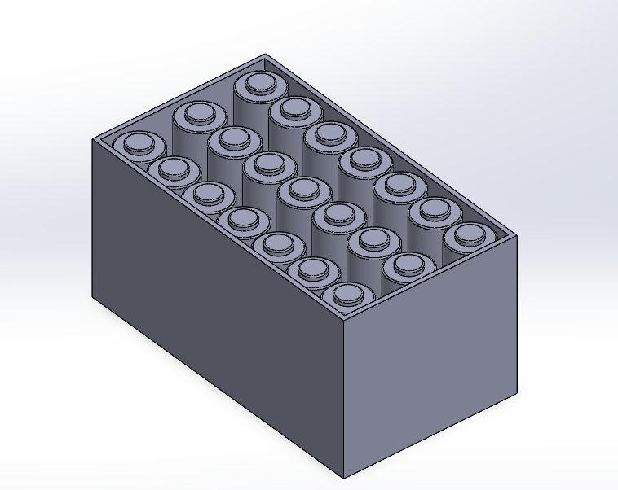
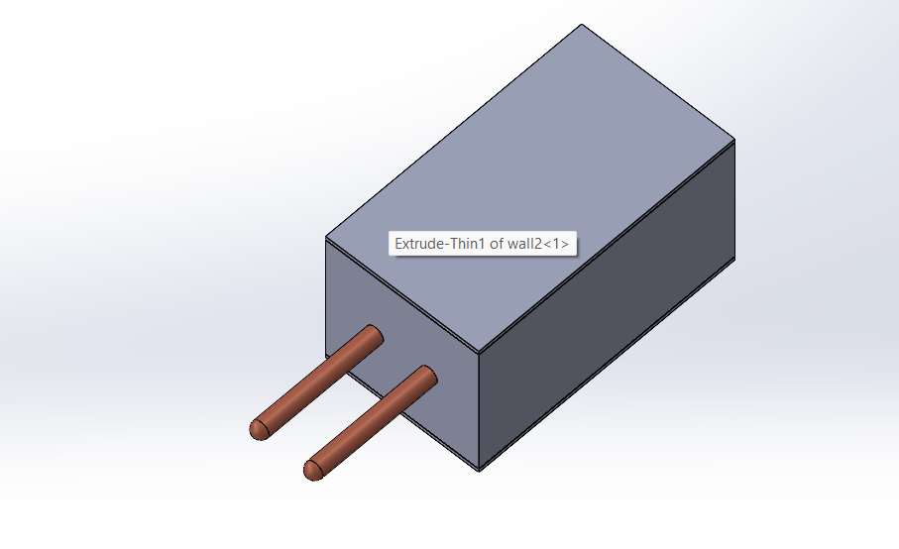
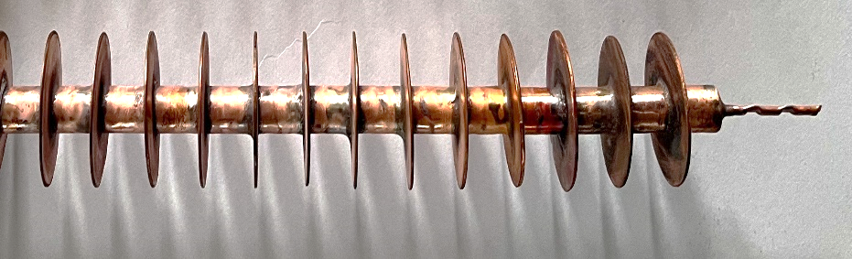
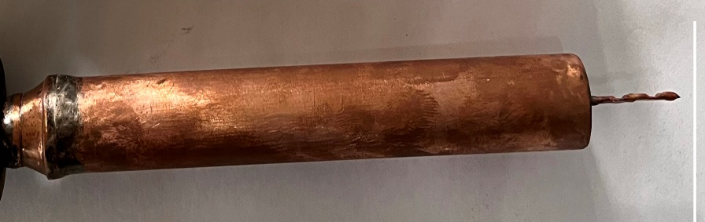
Innovation
Heat pipe integrated system with varying condenser section.
Battery pack model for Thermal management of li-ion batteries using Heat pipe techniques.
Peltier cooling system is integrated with the battery pack
Dielectric liquid integrated with the heat pipe system.
Effective and leakage free.
Uniform temperature distribution.
CAD Model of the Battery Pack
CAD Model of the Integrated System
Finned Condenser Section
Enlarged Condenser Section

Slide 5
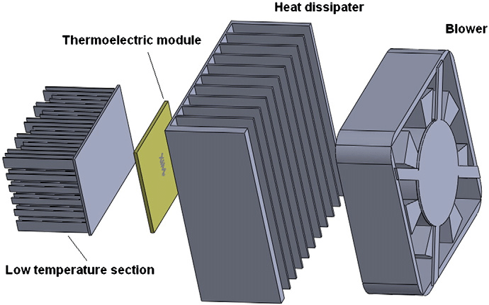
Peltier cooling system
Peltier module (thermoelectric module) is a thermal control module that has both "warming" and "cooling" effects. By passing an electric current through the module, it is possible to change the surface temperature and keep it at the target temperature.
It is a cooling system it cool without compressor

Slide 6
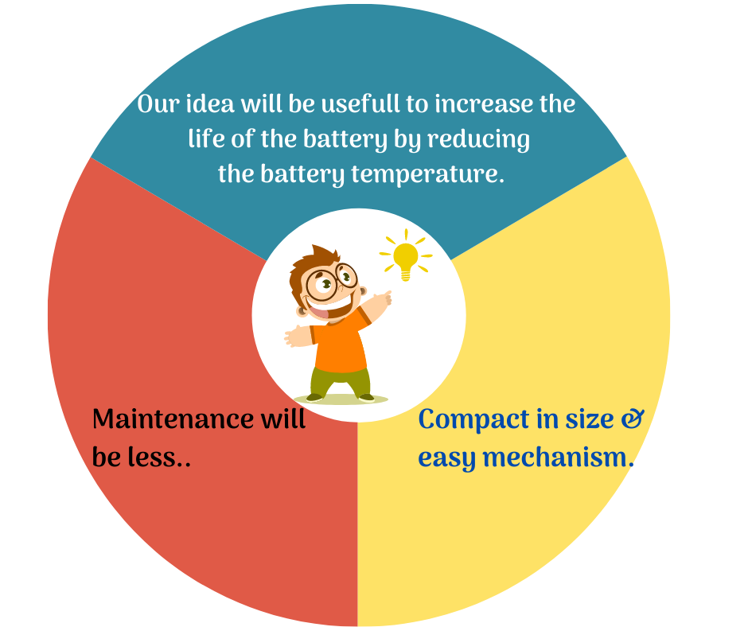
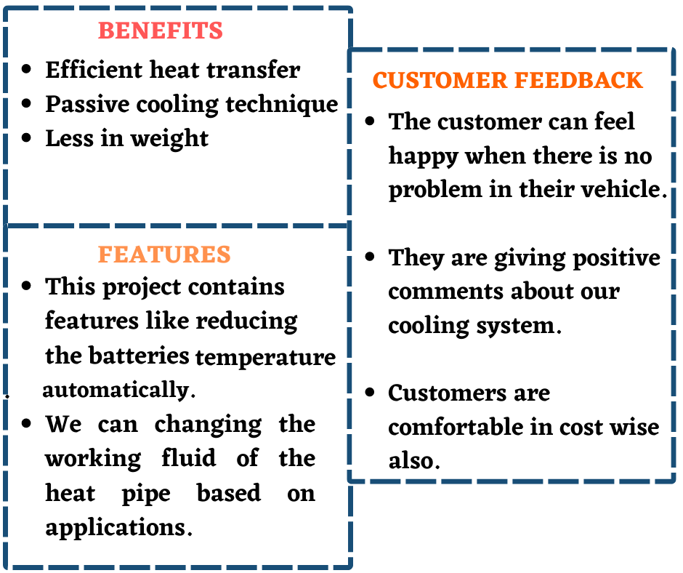
Value proposition:

Slide 7
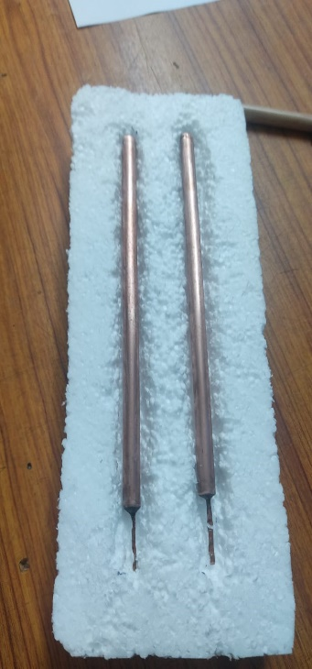
Heat Pipe Specification
Heat Pipe
Outer Diameter | 8 mm
Inner Diameter | 6.5 mm
Length | 190 mm
Wick Mesh | Screen Mesh
Material | Copper
Working Fluid | Acetone
Fill Ratio | 30 %
Pressure | 0.1 bar
Evaporator Section

Slide 8
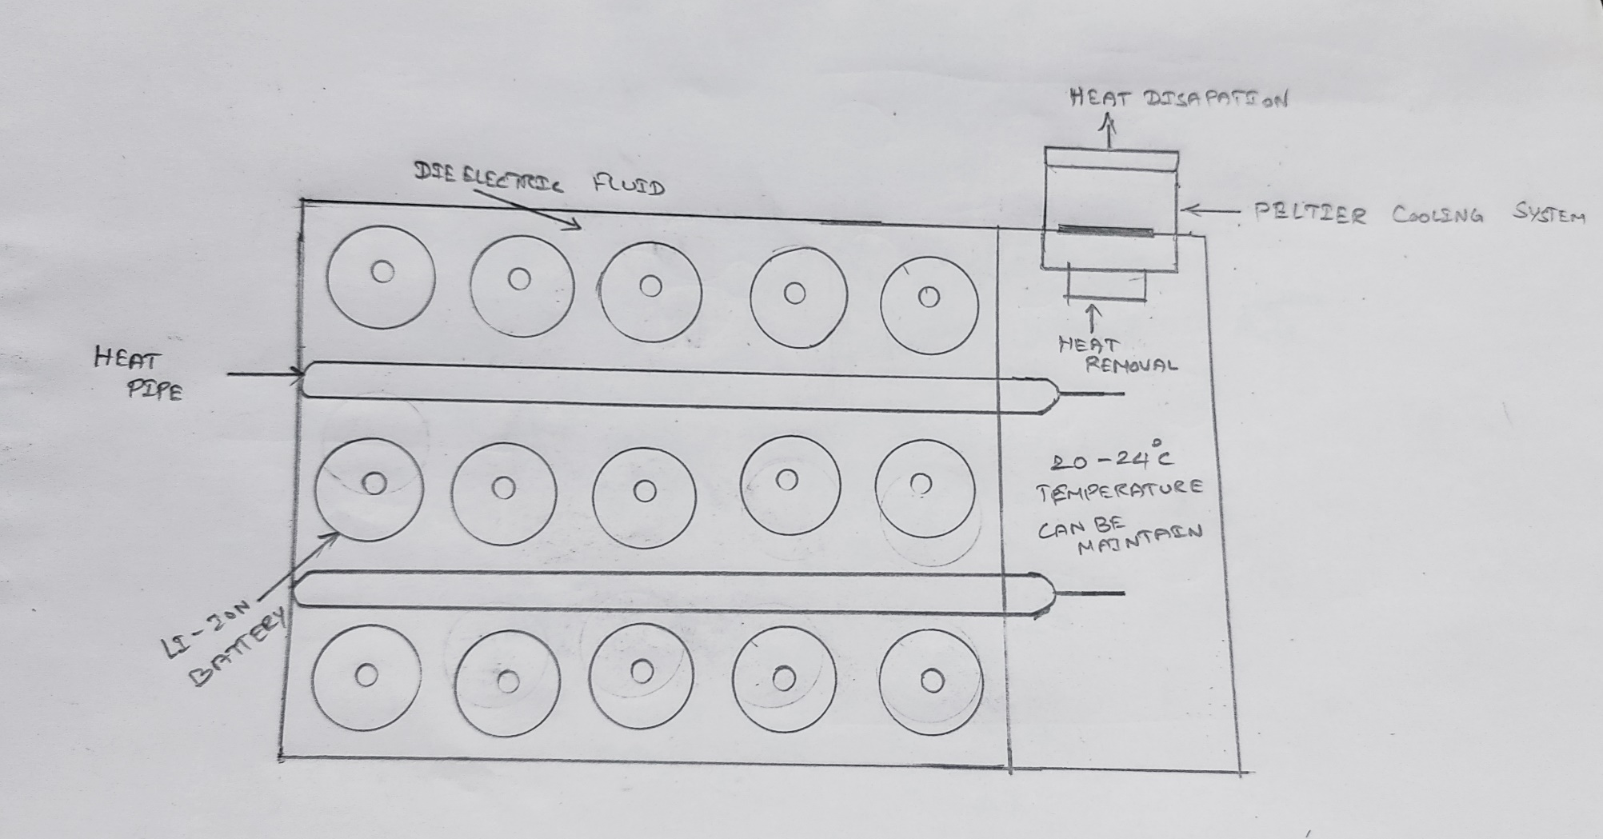
Block diagram

